Slide 1
The Service Desk

Slide 2
Goal – Primary Objective
To act as the central point of contact between the User and IT Service Management
To handle Incidents and request and provide an interface for other activities such as
  Change Management
  Problem Management
  Configuration Management
  Release Management
  Service Level Management
  IT Service Continuity Management

Slide 3
Why a Service Desk?
Provide a single point of contact for Users
Deliver high quality support to meet business goals
Help identify costs of IT services
Support and communication for changes
Increase user perception and satisfaction
Assist identification of business opportunities
Notes:
Service desk (not Help Desk) demonstrates broader role.

Slide 4
Responsibilities
Receive and record ALL calls from users
Provide first line support
Refer to second line (Generalists) support where necessary
Monitoring and escalation of incidents
Keep users informed on status and progress
Provide interface between ITSM disciplines
Produce measurements and metrics

Slide 5
Setting up a Service Desk
Understand the business needs and requirements
Define clear objectives
Obtain support, budget and resources
Advertise and sell benefits / communicate quick wins
Involve and educate users / train support staff
Types of Service Desk
Local Service Desk
Central Service Desk
Virtual Service Desk

Slide 6
Considerations of a Service Desk
Metrics and management reporting
- Daily, weekly, monthly
- Incident / problem status against service levels
- Service availability / breaches
- Overall performance, achievements and trend analysis
Service Desk Technologies
- Integrated tool sets / Knowledge base / Diagnostic tools
- ACD / IVR systems
- Internet / Intranet capability
- Pager systems / text messaging

Slide 7
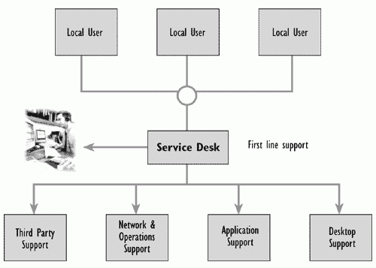
Local Service Desk

Slide 8
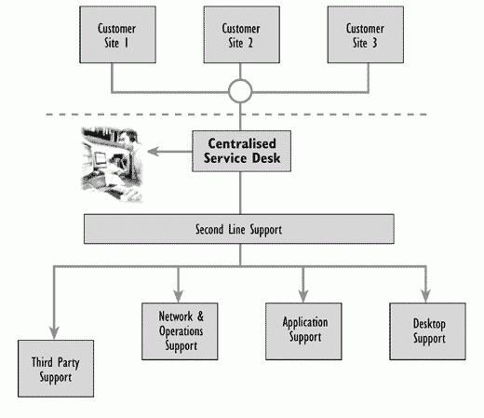
Centralised Service Desk

Slide 9
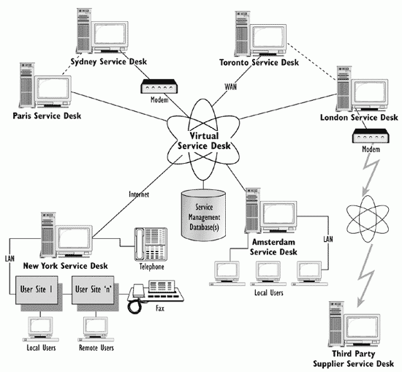
Virtual Service Desk

Slide 10
Benefits of the Service Desk
Improved User service, perception and satisfaction
Increased User accessibility via the single point of contact
Improved quality and faster response to User requests
More effective and efficient use of support resources
Better management information to make decision on support

Slide 11
Exam Tips
A Service Desk staff should NOT be Forthright

Slide 12
Exam Questions
Which of the following lists best describes the key attributes needed by the Service Desk Staff?
A Good interpersonal skills; tenacious; technically astute; firm
B Business aware; articulate; methodical; tolerant; good interpersonal skills
C Logical; methodical; tenacious; forthright; analytical
D Well presented; technical specialists; numerate; good interpersonal skills

Slide 13
Exam Questions
Which incidents should be logged by the Service Desk?
A Only incidents not resolved at logging
B Only incidents from bona fide customers
C All incidents except simple enquiries
D All incidents

Slide 14
Exam Questions
Consider the following metrics:
1 Number of incidents closed on without onward referral
2 Number of incidents correctly categorised at logging
3 Number of hardware faults reported
Which of the above are valid performance indicators for the Service Desk?
A All three
B 1 & 2
C 1 & 3
D 2 & 3

